Slide 1
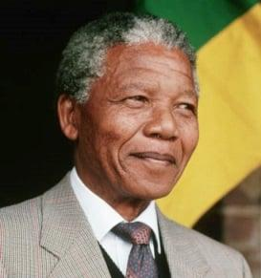
History Quiz (Test)
Email: ndinisamo@gmail.com Cell No. 0647562844
Grade 4
Term 1 & 2 Content
START

Slide 2

Email: ndinisamo@gmail.com Cell No. 0647562844
2. The picture on the left is an example of
Actual evidence ( object)
Written evidence
Oral evidence
NEXT

Slide 3

Email: ndinisamo@gmail.com Cell No. 0647562844
3. The picture on the left is an example of
Oral evidence
Written evidence
Actual evidence ( object)
NEXT

Slide 4
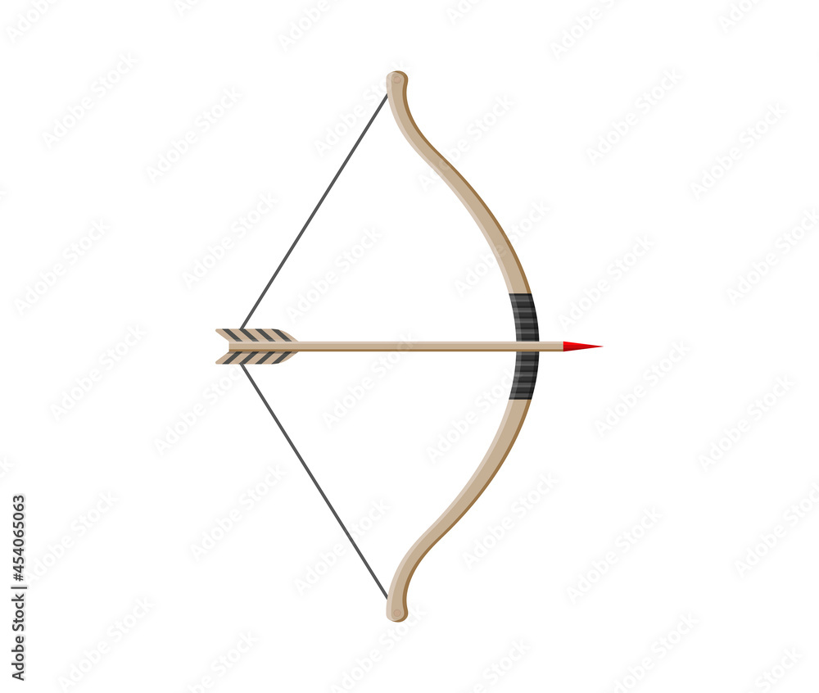
Email: ndinisamo@gmail.com Cell No. 0647562844
4. The picture on the left is an example of
Oral evidence
Written evidence
Actual evidence ( object)
NEXT

Slide 5
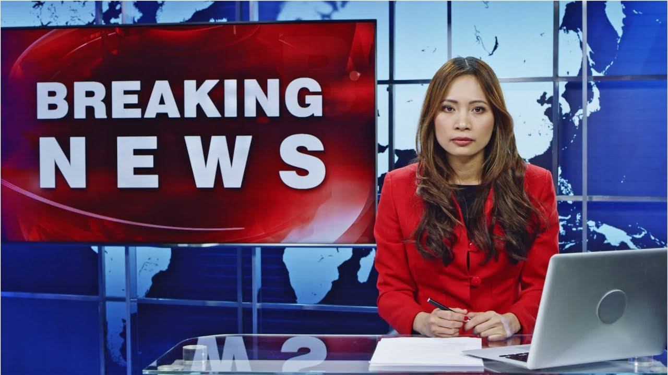
Email: ndinisamo@gmail.com Cell No. 0647562844
5. The picture on the left is an example of
Oral evidence
Written evidence
Visual evidence
NEXT

Slide 6
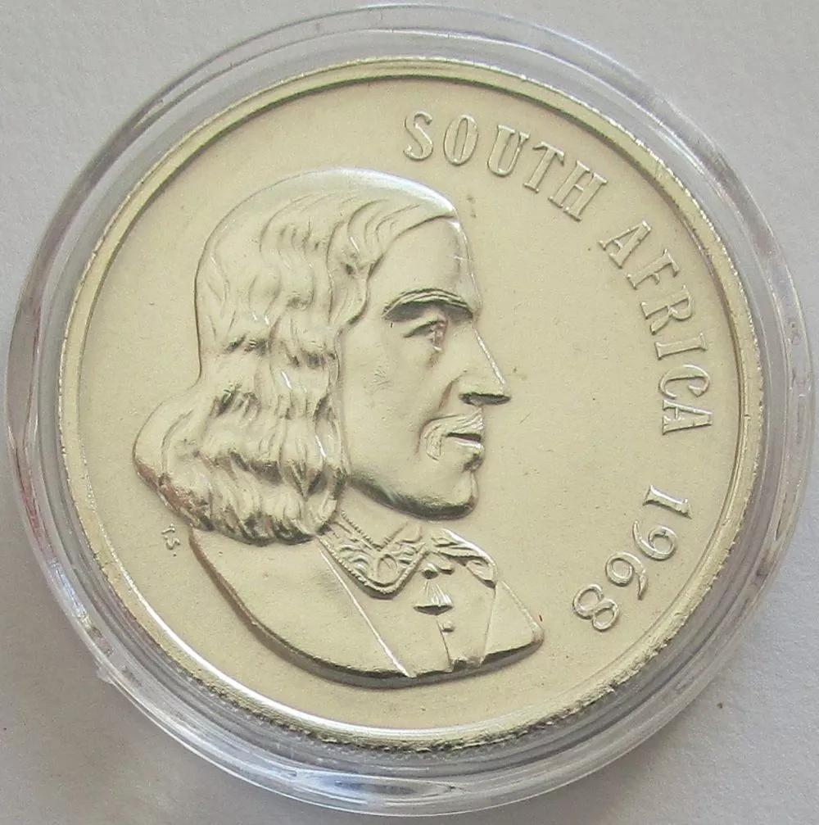
Email: ndinisamo@gmail.com Cell No. 0647562844
6. The picture on the left is an example of
Oral evidence
Written evidence
Actual evidence ( object)
NEXT

Slide 7

Email: ndinisamo@gmail.com Cell No. 0647562844
7. The picture on the left is an example of
Oral evidence
Written evidence
Actual evidence ( object)
NEXT

Slide 8

Email: ndinisamo@gmail.com Cell No. 0647562844
8. The picture on the left is an example of
Oral evidence
Written evidence
Visual evidence
NEXT

Slide 9
Email: ndinisamo@gmail.com Cell No. 0647562844
9. Define the term local area.
The place bigger than the Mars
B. The modern transport system
C. The place where people live
NEXT

Slide 10
Email: ndinisamo@gmail.com Cell No. 0647562844
10. How do we find out about the present in a local area? Explain
We use stories and interviews
B. We collect objects/ remains
C. We study writings in books and papers
NEXT

Slide 11
Email: ndinisamo@gmail.com Cell No. 0647562844
11. Apartheid ended in South Africa in
1990
1993
1994
NEXT

Slide 12
Email: ndinisamo@gmail.com Cell No. 0647562844
12. a)What is the name of the leader?
12.b) What is his political party?
Steve Biko
Nelson Mandela
ANC
DA
EFF
MKP
NEXT

Slide 13
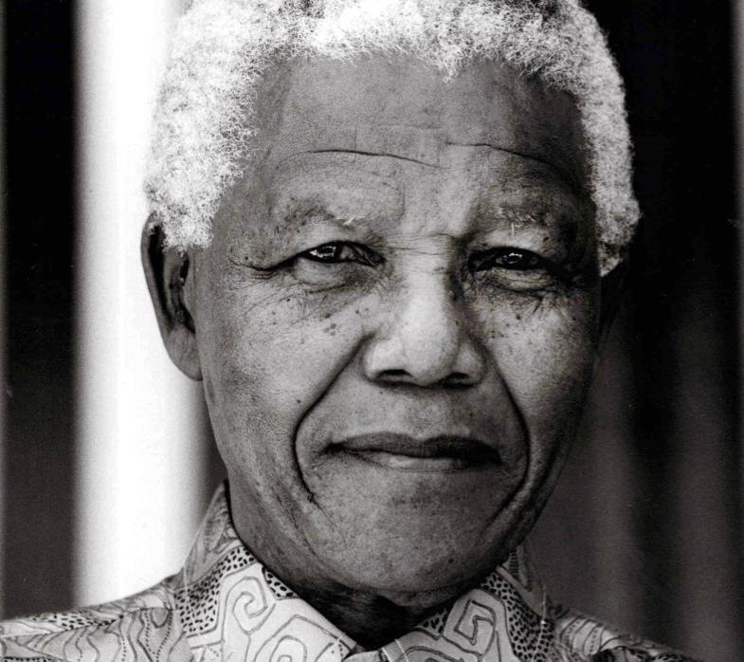
Email: ndinisamo@gmail.com Cell No. 0647562844
13. Name any two good leadership qualities of Nelson Mandela.
Caring and friendly
Cruel and selfish
NEXT

Slide 14
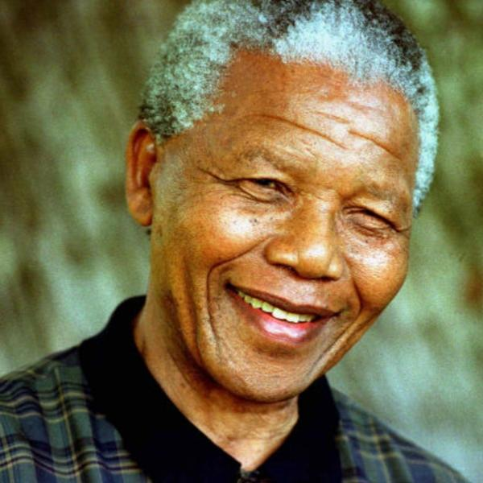
Email: ndinisamo@gmail.com Cell No. 0647562844
14. How many leadership qualities are right about Nelson Mandela?
Honest
friendly
selfish
listens
Respect
caring
cruel
Forgive
8
9
10
Fair
brave
NEXT

Slide 15
Email: ndinisamo@gmail.com Cell No. 0647562844
15. Arrange the following events in a correct order.
In 1964 Mandela was sentenced to life in prison
In 1943 he registered to study law at Wits
In 1993 he was awarded the Noble Peace Prize
In 1918 Mandela was born in Mvezo
In 1990 he was released from prison
A (1918), (1990), (1993), (1964)
B (1918), (1943), (1964), (1990)
THE END
REPEAT QUIZ

Slide 16
BACK

Slide 17

BACK

